Slide 1
How to start selling on Amazon
Adnan Majeed
COMPUTER LEARNING CENTER Lahore

Slide 2
Amazon seller account
Whether you’ve already got an established ecommerce business, a great idea for a new product, or you just have a passion for selling, here’s how to take that next step with Amazon.

Slide 3
Choose a selling plan
With the Individual plan, you’ll pay $0.99 every time you sell an item. The Professional plan costs $39.99 per month, no matter how many items you sell. For both plans, Amazon also collects a referral fee on each sale, which is a percentage of the total transaction and varies by product category. Visit our pricing page for a summary of selling fees.

Slide 4
Consider your selling strategy
Resellers find popular products that already exist and offer them in Amazon's stores. Brand owners manufacture their own products—or source goods to sell under a private label—to offer shoppers unique selection. Lots of sellers do both. You can choose whichever method works for your goals. If you plan to sell your own brand on Amazon, we have lots of resources and tools to help.

Slide 5
Perfect Launch: five steps for your first 90 days
For new Amazon sellers, the first 90 days are especially critical for establishing the right practices to accelerate performance beyond launch. Perfect Launch is what Amazon data scientists call the use of five selling programs—Brand Registry, A+ Content, Fulfillment by Amazon, Automated Pricing, and Advertising—within those first 90 days. New sellers taking these five steps within that critical timeframe can generate sales more quickly, and many of the most successful sellers already have.

Slide 6
Create an Amazon seller account
You can use your customer account to start selling, or you can create a new Amazon seller account with your business email. Residents of these countries are eligible. Before you sign up, make sure you’re ready with the following:
Business email address or Amazon customer account
Internationally chargeable credit card
Government ID (identity verification protects sellers and customers)
Tax information
Phone number
A bank account where Amazon can send you proceeds from your sales

Slide 7
Go mobile
Use the Amazon Seller app to track sales, fulfill orders, find products to sell, respond to customer questions, capture and edit professional-quality product photos, and create listings—all from your phone.

Slide 8
Adding your products
What can you sell on Amazon? It depends on the product, the category, and the brand. Some categories are open to all sellers, some require a Professional seller account, some require approval to sell, and some include products that cannot be sold by third-party sellers. The table below provides an overview of Amazon product categories, but visit Seller Central Help to learn more about restrictions, and how to request approval. If you ship orders with Fulfillment By Amazon, be sure to review the specific list of FBA product restrictions.

Slide 9
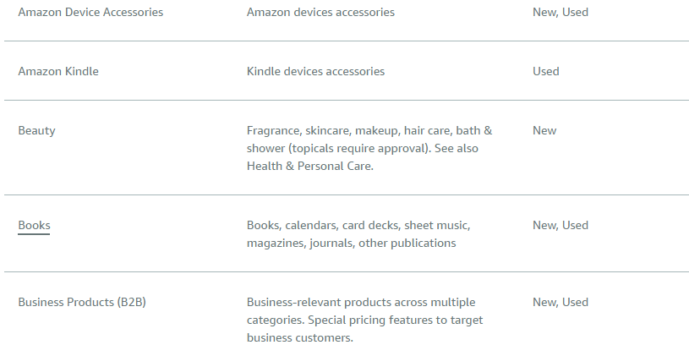
Product categories

Slide 10
Product listing details
To start selling a product on Amazon, you’ll create a product listing in Seller Central (or via API). A product listing includes:
A product identifier, such as GTIN, UPC, ISBN, or EAN to specify the exact item you’re selling. You can get a UPC code directly from GS1, or request an exemption.
A SKU, which is a product ID you create to track your own inventory
Offer details, including price, product condition, available quantity, and shipping options
Product details like name, brand, category, description, and images
Keywords and search terms to help buyers find your product
If another seller already offers the same product, you’ll match an existing listing (which means some details will already be in place, like the product identifier). If you’re the first seller to offer a product, you’ll create a new listing.

Slide 11
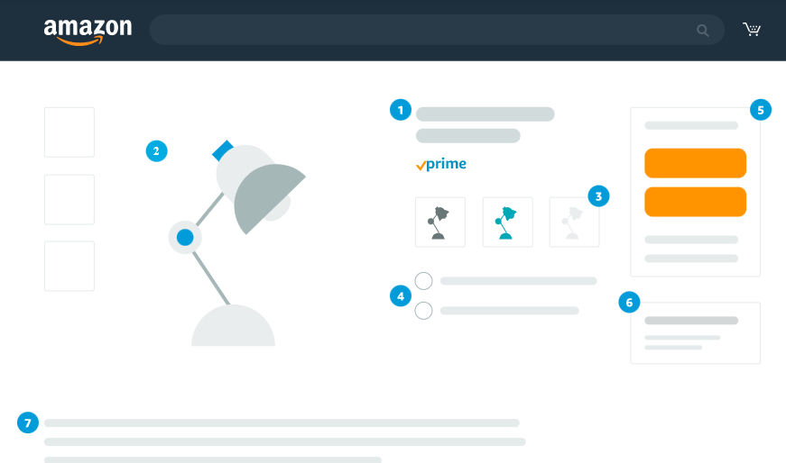
The product detail page

Slide 12
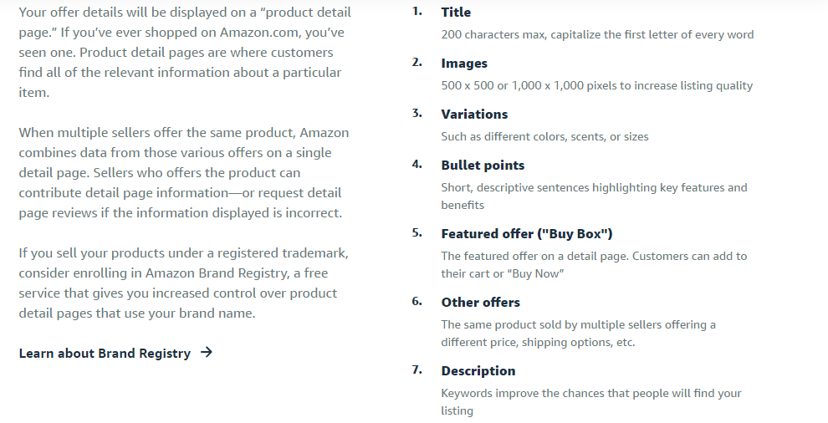
Product detail page

Slide 13
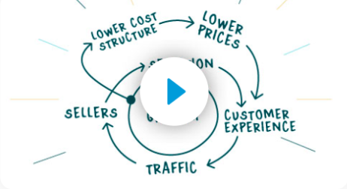
Attracting customers
Once your products go live in Amazon's stores, there are a number of things you can do to attract customers. The Amazon Flywheel describes our method for driving growth. Below are some ways to consider using “Amazon Flywheel” principles to generate momentum for your business.

Slide 14
Provide fast shipping
Customers often shop products with the Amazon Prime badge, which you can get by using Fulfillment by Amazon (FBA) to ship products from one of our fulfillment centers.

Slide 15
Advertise your offers
Help improve visibility of individual products and boost brand awareness by advertising in search results and on product pages. Running a deal or a coupon is another way to promote your products.

Slide 16
Set competitive prices
Many customers shop for the best price. Seller Central tools like automated repricing and bulk pricing for Amazon Business customers can help you stay competitive.

Slide 17
After your first sale
The moment you’re selling on Amazon is the moment you can start growing. We have tools in place to help you take things to the next level and then some.

